Slide 1
Laboratory Medicine Core Data Analysis
Lesson 3
Importing Data

Slide 2
Lesson Goals
Learn functions to import data
Practice using tools that help in reviewing imported data
Lesson Objectives
Import laboratory data from a common flat file format
Inspect imported data with the built-in RStudio viewer
Tabulate one or two variables as another inspection method

Slide 3
Working with R Markdown for this course
Each lesson has an R Markdown file
Executable examples
Exercises
Files used as “notebooks”: can document, execute, and iterate
Best practice: work from notebook rather than console

Slide 4
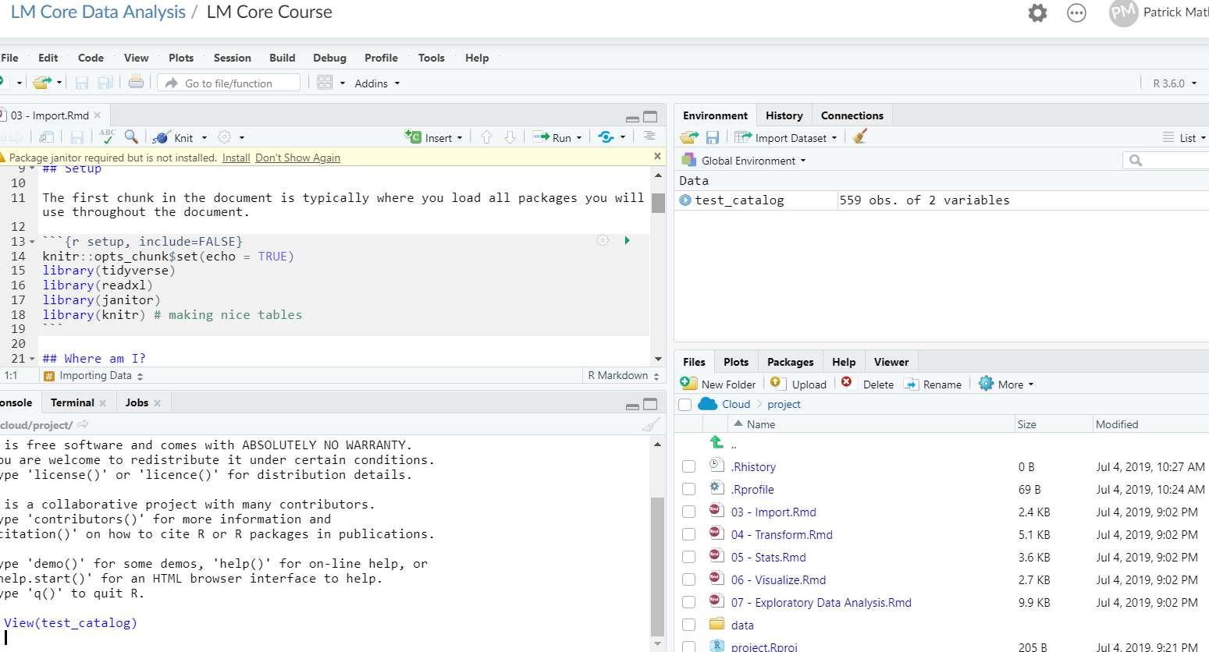
Your Turn #1
Open “03 – Import.Rmd”
Run the setup chunk

Slide 5
Importing Files
Notes:
Covered the basics of working with a R Markdown document
Now let’s get into the first step of our analysis pipeline: importing data
Before we launch into file import though, we have to briefly think about the file system to be able to point R to the right place

Slide 6
Working with your file system
Working directory
Notes:
Whenever you are interacting with files in R your point of reference is important
You can navigate your files in a similar way to your operating system with Rstudio
Here I am showing the folder for the course materials on my OS X operating system
I am currently in the api_r2019 folder which we can call my working directory since I can work on files at this level

Slide 7
Where am I? Your working directory
Navigate folder and file structure on your computer from Rstudio
getwd() function will tell you which folder you’re in
setwd() to set a new working directory
Navigate folders and set working directory
Notes:
Bottom right side of your Rstudio window you should see a “Files” tab
This allows you to move through your OS directory structure
Because you are using Rstudio Cloud you see a simple structure based on this specific project, but when open on your computer you can navigate through your own files
Note: can set up your working directory in code, but unlikely to work for anyone else
Now that we’ve thought about where to get your files, lets talk about importing them

Slide 8
Reading comma separated or tab delimited files
read_csv(“data/test_catalog.csv”)
File type (csv, tsv, delim for non-standard delimiters)
File path (if file in a folder within working directory)
File name
Notes:
One common non-Excel format is a csv or comma separated value file
Functions that start with read_ from the readr package are built to handle these common formats

Slide 9
Your Turn #2
order_id | patient_id | description | proc_code | order_class_c_descr | lab_status_c | lab_status_c_descr | order_status_c | order_status_c_descr
19766 | 511388 | PROTHROMBIN TIME | PRO | Normal |  |  | 4 | Canceled
88444 | 511388 | BASIC METABOLIC PANEL | BMP | Normal |  |  | 4 | Canceled
40477 | 508061 | THYROID STIMULATING HORMONE | TSH | Normal | 3 | Final result | 5 | Completed
97641 | 508061 | T4, FREE | T4FR | Normal | 3 | Final result | 5 | Completed
99868 | 505646 | COMPREHENSIVE METABOLIC PANEL | COMP | Normal | 3 | Final result | 5 | Completed
Find and import the orders data set and store in an object called ”orders”
View the data by clicking on the object name in the environment tab
Run the summary function on the data
Notes:
Let’s go ahead and practice pulling this data in and taking a quick look at it
Now that we are working within the Markdown document you can work on the exercise within a code chunk there
Plus you can write any notes you need

Slide 10
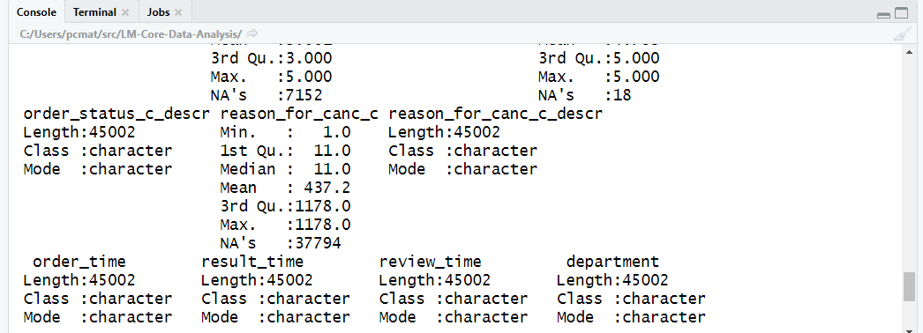
What is NA?
“Not available”
Equivalent to NULL in some other languages
Represents missing values
Notes:
We briefly introduced summary in the first lesson and I am re-orienting you to it here
Nice way to quickly visualize summary statistics
Limited for fields that are characters, but if a field is a categorical variable, or what we would call a factor in R, summary will show some information about counts
You probably want to make the decision to convert something to a factor, though
One thing I’d like to point out about the summaries here for our numerical and datetime data: these counts of “NA”s
What are those?

Slide 11
Why are the time variables characters?
Notes:
You might expect that R would recognize dates and times as distinctive data types but it appears here that R is storing these data as characters
Let’s drill down in a little more detail by viewing the data

Slide 12
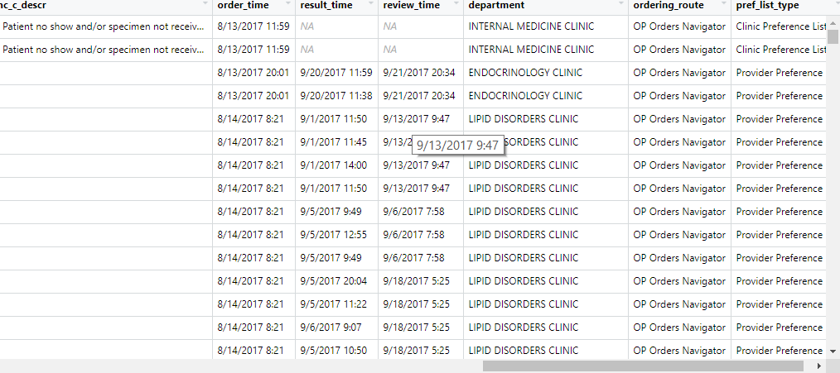

Slide 13
Data types/formats can be specified on input
orders <- read_csv("data/orders_data_set.csv",
col_types = cols(
order_time = col_datetime("%m/%d/%Y %H:%M")
)
)
Column types argument to force data type
Datetime format

Slide 14
Your Turn #3
1. Import the result_time and review_time columns so they are also datetimes
2. Review the imported data with summary()
Notes:
Let’s go ahead and practice pulling this data in and taking a quick look at it
Now that we are working within the Markdown document you can work on the exercise within a code chunk there
Plus you can write any notes you need

Slide 15
Tabulating Data
Notes:
Last part of this lesson: simple ways to quickly understand and visualize data, starting with creating tables

Slide 16
Orders Data Set
Data set of outpatient laboratory orders
45,000 rows x 17 columns
Queried from Epic orders data (Clarity)
Deidentified and time shifted
Includes timestamps for lab order, result, and provider review
Variable | Description
order_id | Key for order
patient_id | Key for patient
description | Text description of lab test
proc_code | Procedure code for lab test
order_class_c_descr | Setting test is intended to be performed in (eg. Normal = regular blood draw)
lab_status_c | Code for status of laboratory result
lab_status_c_descr | Status of laboratory result
order_status_c | Code for status of order
order_status_c_descr | Status of order
reason_for_canc_c | Code for cancellation reason (if applicable)
reason_for_canc_c_descr | Cancellation reason (if applicable)
order_time | Timestamp for time of original test order
result_time | Timestamp for most recent result in the record
review_time | Timestamp for provider acknowledgment of review of result
department | Clinic associated with test order
ordering_route | Structure/menu in health record from which order was placed
pref_list_type | Category of preference list (if applicable)
Notes:
Before we launch into that, it’s helpful to know some background about the data we’re analyzing for most of today

Slide 17
Create a one variable table
Data frame
Row variable
tabyl(orders, department)
Notes:
There are built in table functions in R but there are some advantages to using table functions from the janitor package, which we loaded during Joe’s lesson
Biggest advantage: output is a data frame that can easily be manipulated downstream (without being coerced into a different data type)
Simplest example is a one variable table
First argument = data frame
Second argument = variable whose values will become the rows in your tabulation

Slide 18
Two variable tables can help answer simple questions quickly
Which clinic cancelled the highest number of lab orders?
Data frame
Row variable
tabyl(orders, department, order_status_c_descr)
Column variable
Notes:
Now we can add another level of complexity by adding an additional variable
The third argument to the function now determines values of the columns in the tabulation

Slide 19
Your Turn #4
Which 3 departments ordered the highest number of labs using “Provider Preference Lists”?
What happens if you add another variable to the tabyl() function (3 variables)?
Notes:
Let’s practice this and see if we can take it further

Slide 20
What Else?

Slide 21
Working with dates and times
https://lubridate.tidyverse.org/index.html
https://lubridate.tidyverse.org/index.html

Slide 22
Reading Excel files
File name
read_excel(“data/excel_file.xlsx”,
sheet = 1)
Specify sheet by number or ”name”
Can also extract arbitrary rows and columns using “range = “ argument
Notes:
We commonly work with Excel files all the time and it is probably the common format across most laboratories
The readxl package helps us read data from these files
Similar format to the readr files we just discussed but additional optional arguments are allowed, including to point R to the specific sheet you are importing

Slide 23
Writing files
File type
Data to write out
write_csv(catalog, “output/test_catalog.csv”)
Output file name
(separate output from raw data!)
Notes:
Before moving on, want to mention writing files
Similar syntax to reading files
First argument is the data frame you want to write to a file

Slide 24
Prettifying Table Output
kable(tabyl(orders, department, pref_list_type))
Notes:
The default formatting for table output from code chunks is not particularly clean or publication worthy
But it is pretty easy to clean this up with one line using the knitr package
Kable function can be applied to any table output to produce a nice output

Slide 25
Lesson Goals
Learn functions to import data
Practice using tools that help in reviewing imported data
Lesson Objectives
Import laboratory data from a common flat file format
Inspect imported data with the built-in RStudio viewer
Tabulate one or two variables as another inspection method

